Slide 1

Excel Chart Basic
Prepared By By
Said Fawzy

Slide 2
What we will cover
How to Insert a Chart
How to Adjust a Chart
How to Improve a Chart
Add Series to a Chart
Create Combination Chart

Slide 3

Chart Basics

Slide 4

Inserting a Chart

Slide 5
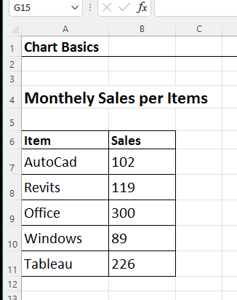
We want to Visualize this data set

Slide 6
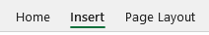
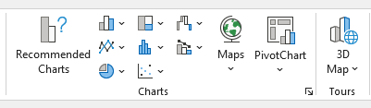
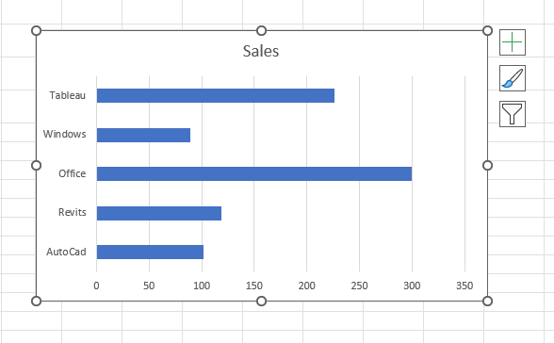
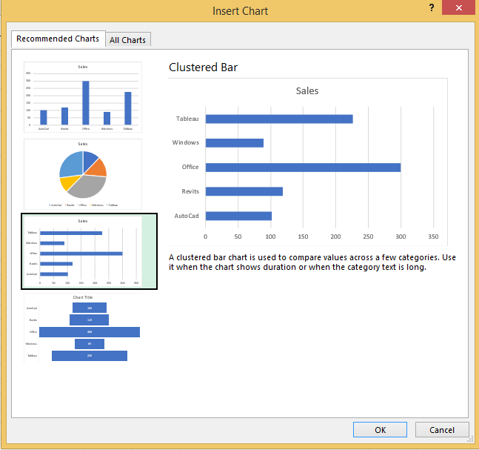
Item | Sales
AutoCad | 102
Revits | 119
Office | 300
Windows | 89
Tableau | 226
Highlight dataset
Excel Gives you Proposals

Slide 7
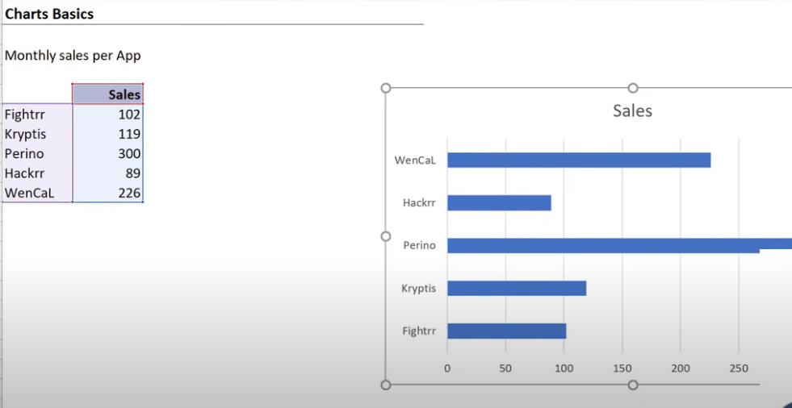

Slide 8
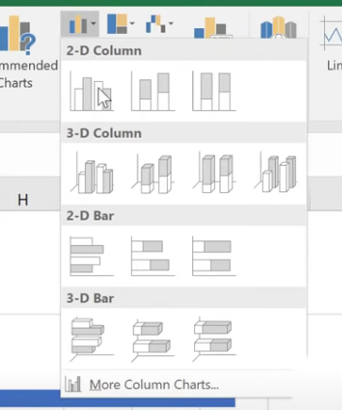
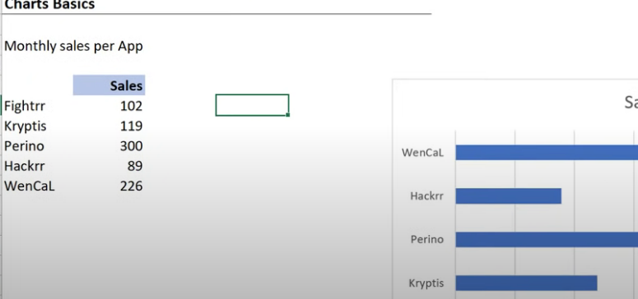
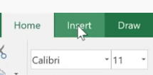
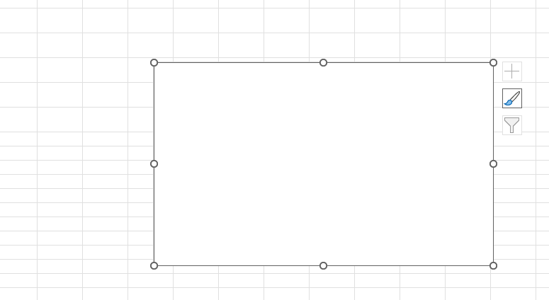
if you didn’t highlight the data set
You got an empty chart

Slide 9
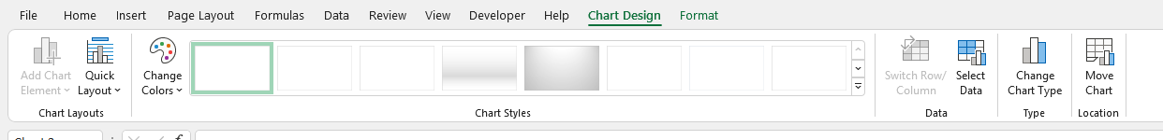
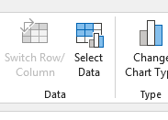
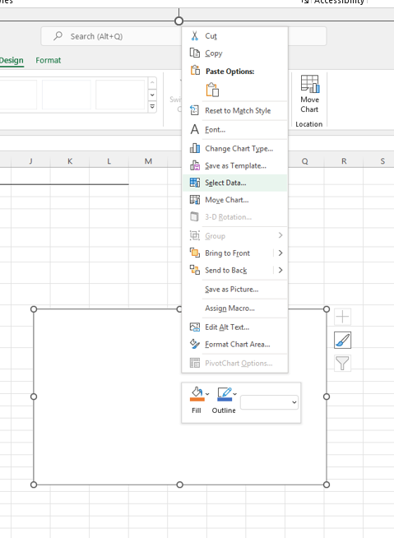
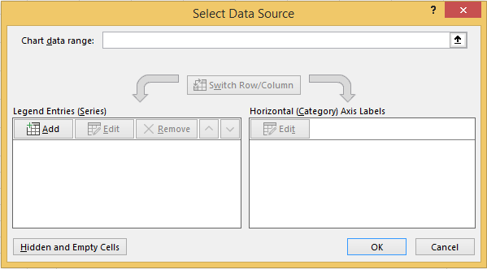
When you insert chart ,Notice that you have 2 new taps
if you want add data to your empty combos You can select data
Or

Slide 10
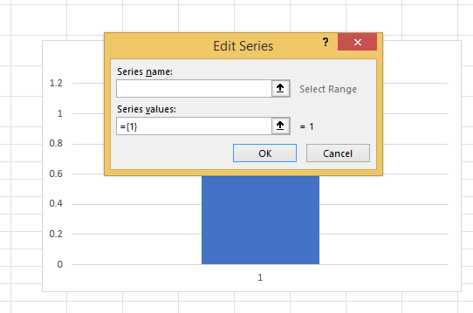
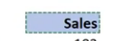
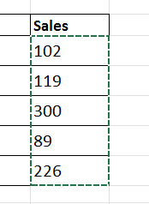
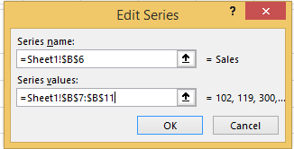
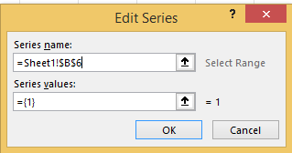
You can add different elements manually
Add the name
Add the Value

Slide 11
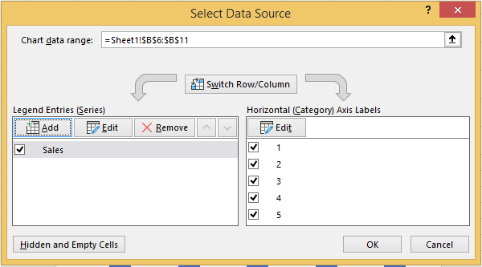
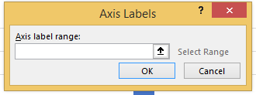
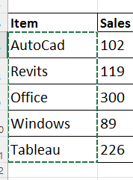
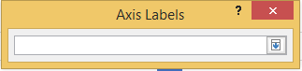
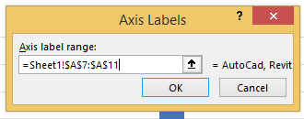
As you can see Labels are missing

Slide 12
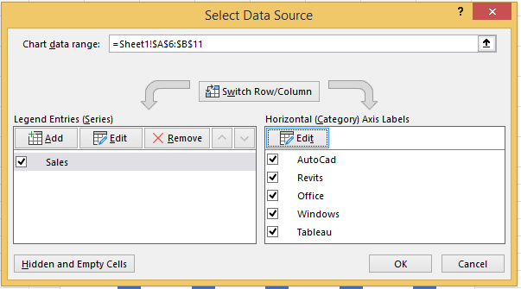
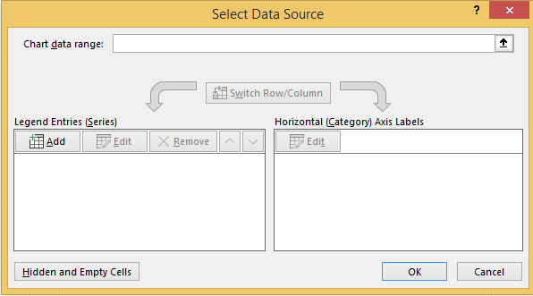
Here ,You can Edit or remove data
Let us Delete our series now and try something else

Slide 13
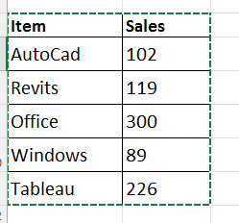
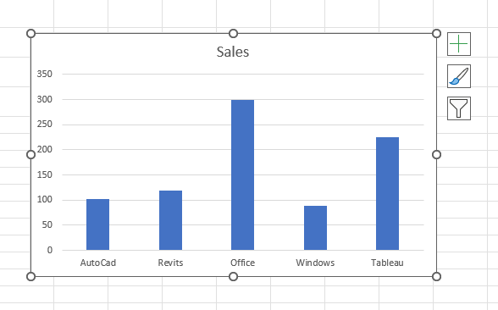
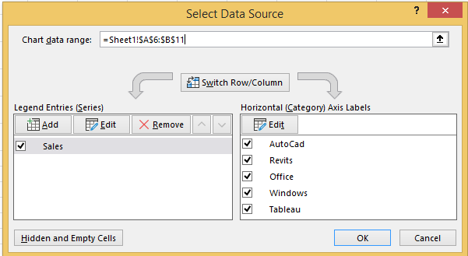
The fast way add data series with name ,values and labels is :

Slide 14
Delete all charts you have done ,and let us try something else

Slide 15
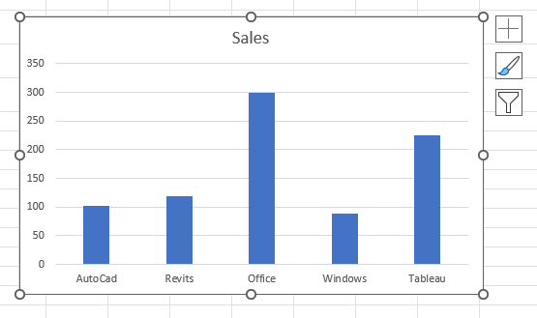
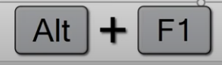
The Quickest way to insert a chart is to
Item | Sales
AutoCad | 102
Revits | 119
Office | 300
Windows | 89
Tableau | 226
Highlight dataset
This insert your Default Chart

Slide 16
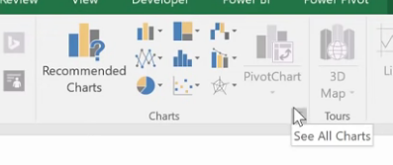
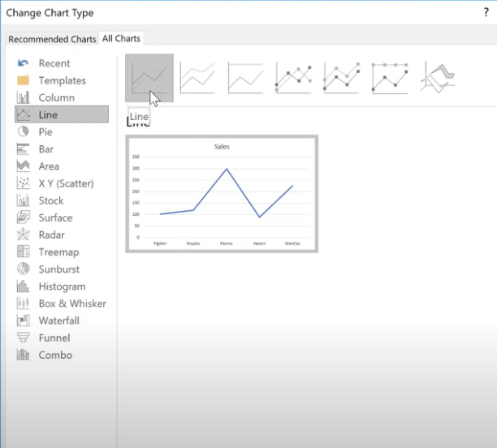
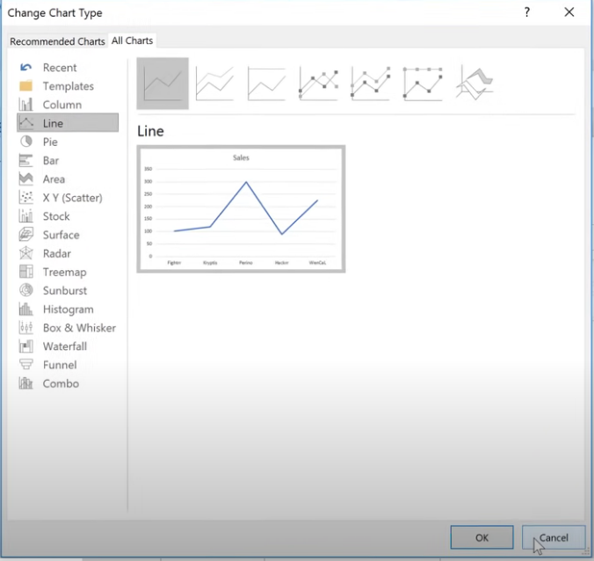
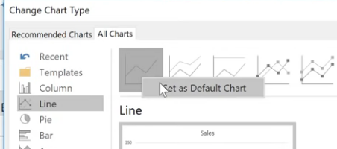
How to change your default Chart
Chose Cancel

Slide 17
Delete all charts you have done ,and let us try something else

Slide 18
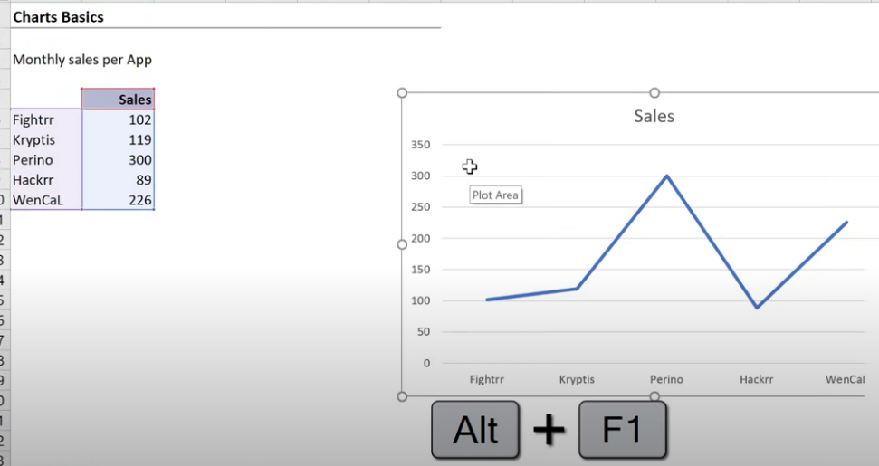
Now Try your new default chart

Slide 19
Adjusting the Chart

Slide 20
Delete all charts you have done ,and let us try something else

Slide 21
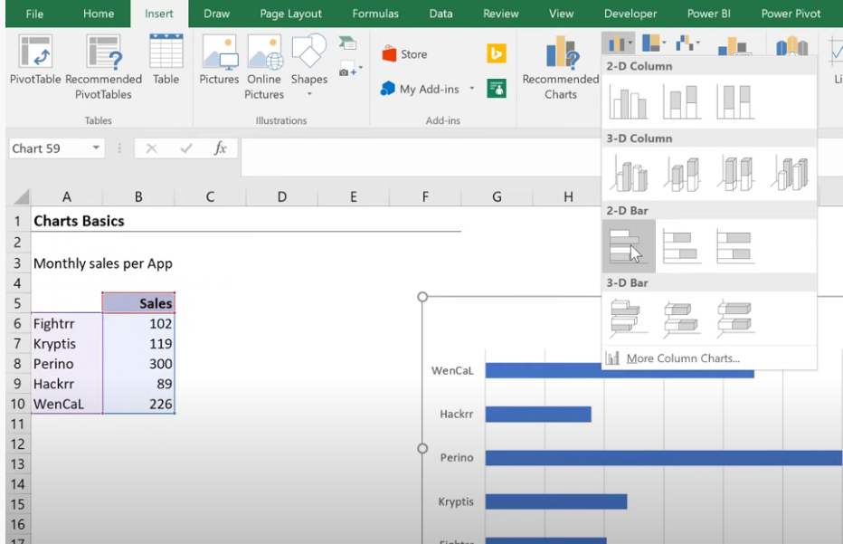
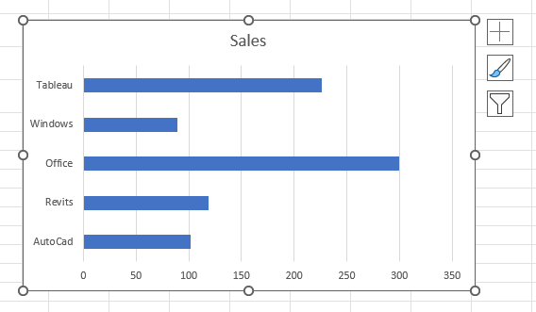
Suppose I want to insert a bar chart

Slide 22
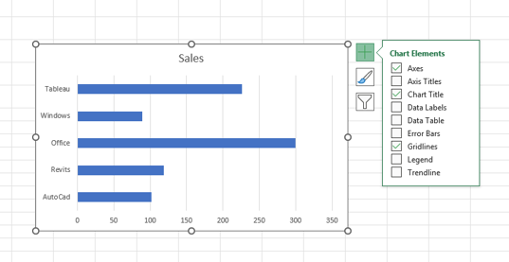
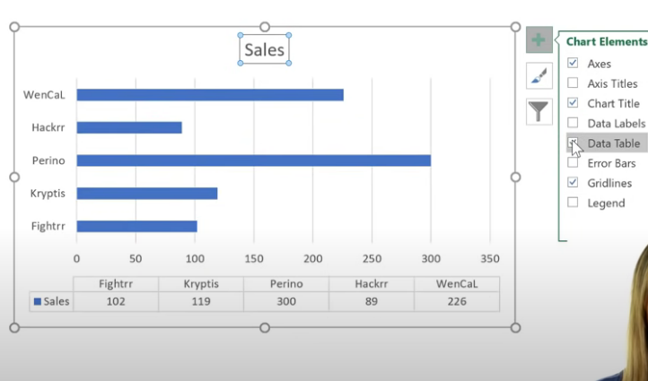
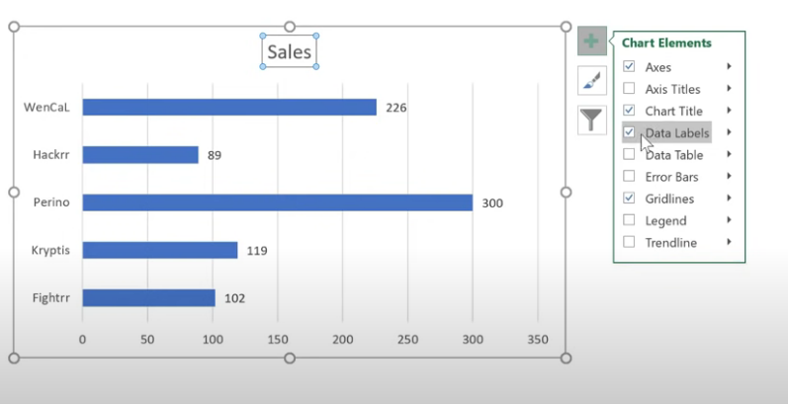
Control Chart elements :
Add Data table
To add or remove a Chart element
Add Data Labels

Slide 23
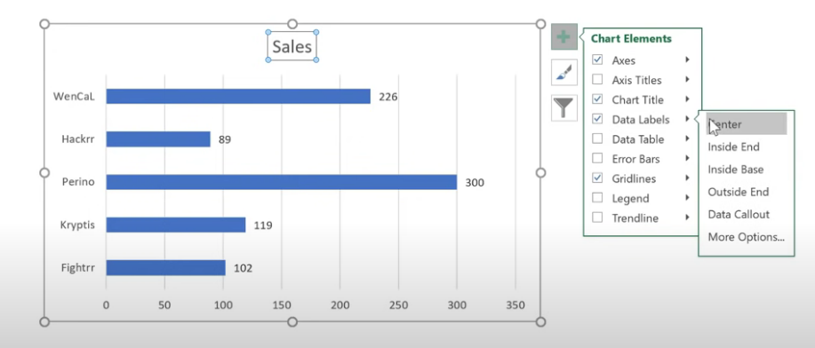
Control Chart elements
Press Arrow to select where you want your data label appear

Slide 24
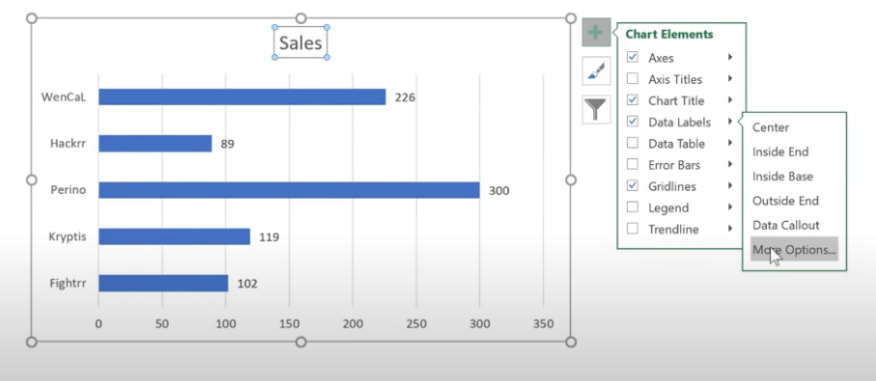
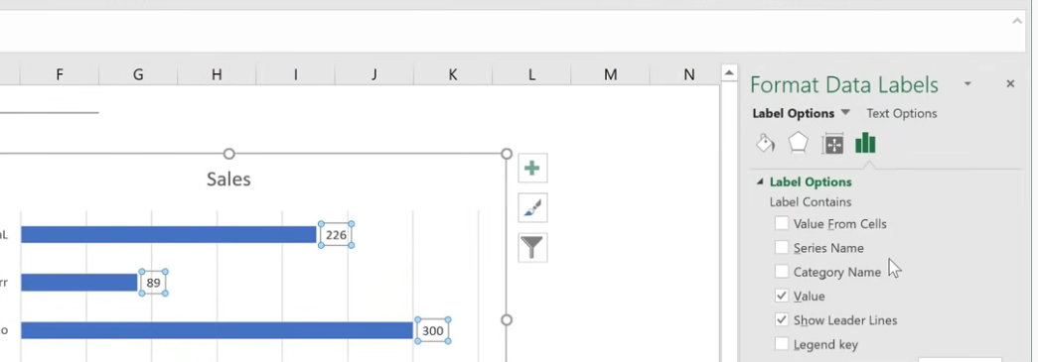
Control Chart elements
You can click more options
To have full control of all element options

Slide 25
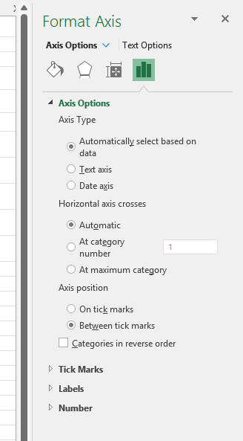
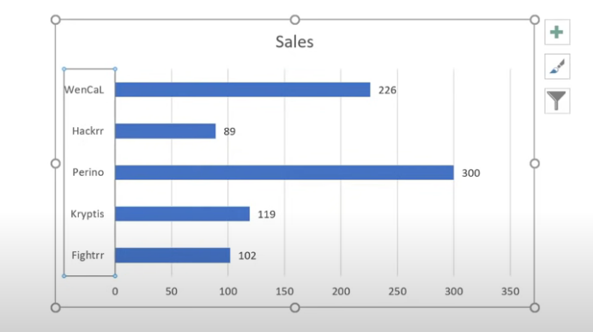
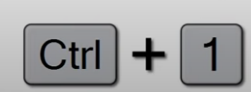
Element Format
Double click the element
or
1
2
To get the format options

Slide 26
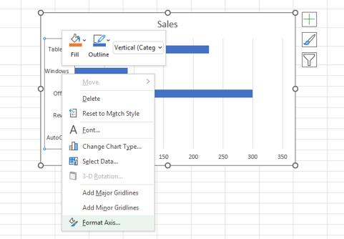
Element Format
3
Or right click and chose format ……
To get the format options

Slide 27
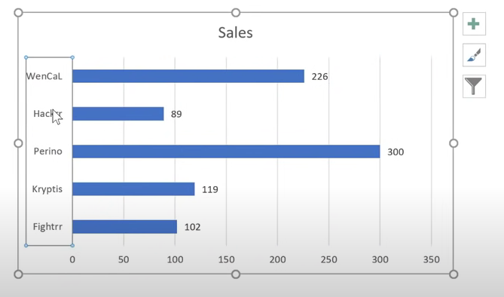
Element Options
Keep the format option dialogue box activated and move from one element to another to change its options

Slide 28
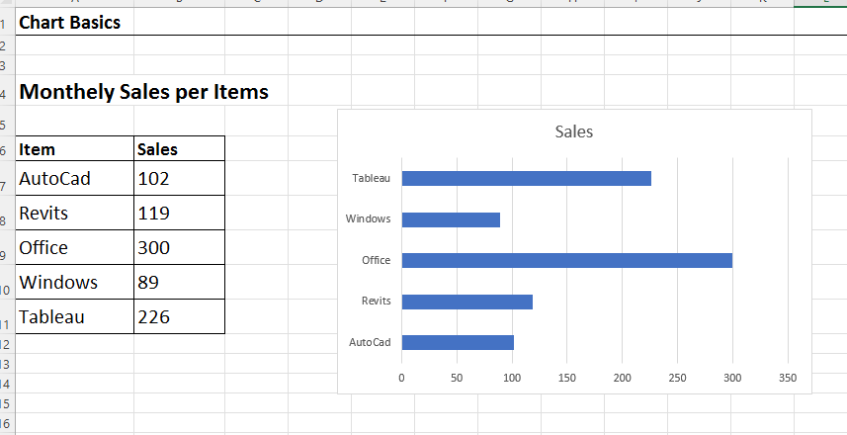




Reverse Access
Double click the Axis

Slide 29




Change Gab width
Select the data series

Slide 30



To remove an element
Just select it and prese Delete

Slide 31
Improving Chart

Slide 32



Format an element
Or
Use the format Menu
2
1
Click the element first , then use the format dialogue box
If an option you use a lot , you can add to Quick access toolbar

Slide 33

Format an element
3
Or right click the element and change the fill color and out line directly

Slide 34


Enlarge your Axis line and change its color

Slide 35

Change Axis text fonts and color
You can use the Home tab to Increase size and make it Bold

Slide 36
Adding More Series

Slide 37




Add a new series to the Chart
The Easiest way is to expand data series
But , Be sure to select the Chart Area

Slide 38




Another way to add data series
Right click and chose select Data
And Manually add your series
You can directly Type the name
And select the series values

Slide 39


Now you have 3 data series

Slide 40


You can Change the series order
Pushing the series up and down
And you can remove

Slide 41


If you can’t see a series because it is white or has no fill for example
Select the data
series you want
And change its color and format
Select the Grid then select from the drop down list the series
Notice you can switch between Chart objects from the list

Slide 42
Creating
Combination Charts

Slide 43



If you want to show budget as another series with another scale or shape like line shape
Select change series Chart type

Slide 44




or select the Chart Area and Select change Chart type
Click Combo
Change the series

Slide 45




Make the second series only appear as DASH LINE
Change format to no line
Select the line
Select Marker Option
Change the type

Slide 46


Make the second series only appear as DASH LINE
Change the type and size – Fill –Color –Border

Slide 47





Add Data Label

Slide 48

Add Data Label
Change Color to white

Slide 49




Add Data Label
Select the other data series
Make labels on Top

Slide 50

Add Data Label

Slide 51





We still have two elements missing
Change the title
Make the legend on Top

Slide 52




We still have two elements missing
Make the legend Actual – Budget
And Here We Go
Delete the Y Axis

Slide 53
Final Chart

Slide 54
Thanks
Said Fawzy

